Slide 1
Youth welfare department
System Analysis

Slide 2
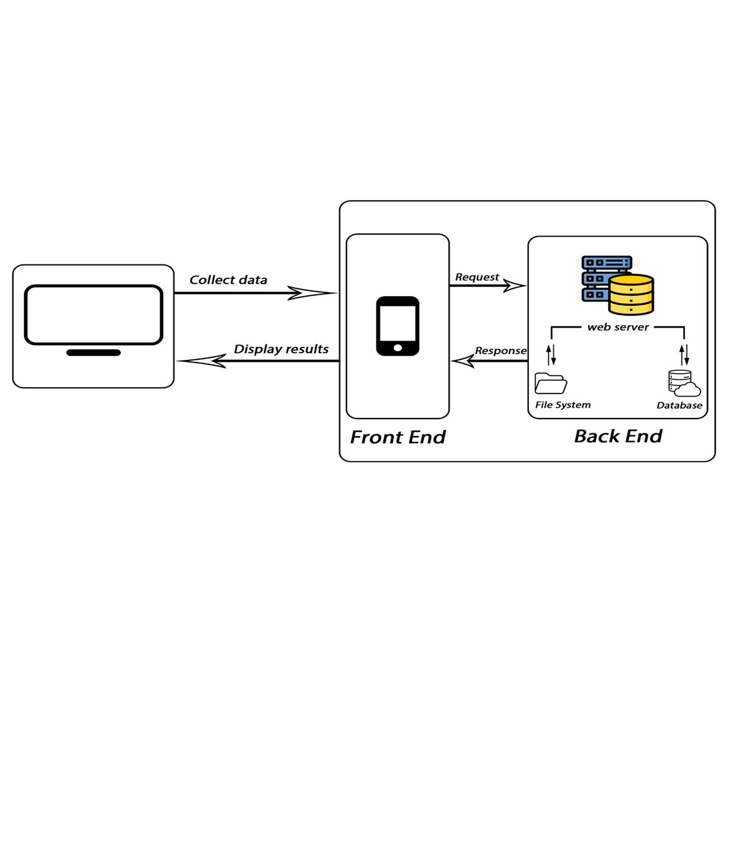
System architecture

Slide 3
Uml diagrams

Slide 4
Use case diagram
To model a system, the most important aspect is to capture the dynamic behavior. Dynamic behavior means the behavior of the system when it is running/operating. Only static behavior is not sufficient to model a system rather dynamic behavior is more important than static behavior. In UML, there are five diagrams available to model the dynamic nature and use case diagram is one of them. Now as we 57 have to discuss that the use case diagram is dynamic in nature, there should be some internal or external factors for making the interaction. These internal and external agents are known as actors. Use case diagrams consists of actors, use cases and their relationships. The diagram is used to model the system/subsystem of an application. A single use case diagram captures a particular functionality of a system. Hence to model the entire system, a number of use case diagrams are used:

Slide 5
Purpose of use case diagrams
The purpose of use case diagram is to capture the dynamic aspect of a system. However, this definition is too generic to describe the purpose, as other four diagrams (activity, sequence, collaboration, and State chart) also have the same purpose. We will look into some specific purpose, which will distinguish it from other four diagrams. Use case diagrams are used to gather the requirements of a system including internal and external influences. These requirements are mostly design requirements. Hence, when a system is analyzed to gather its functionalities, use cases are prepared and actors are identified. When the initial task is complete, use case diagrams are modelled to present the outside view in brief, the purposes of use case diagrams can be said to be as follows:

Slide 6
Purpose of use case diagrams
Used to get an outside view of a system.
Used to gather the requirements of a system.
Show the interaction among the requirements are actors.
Identify the external and internal factors influencing the system

Slide 7
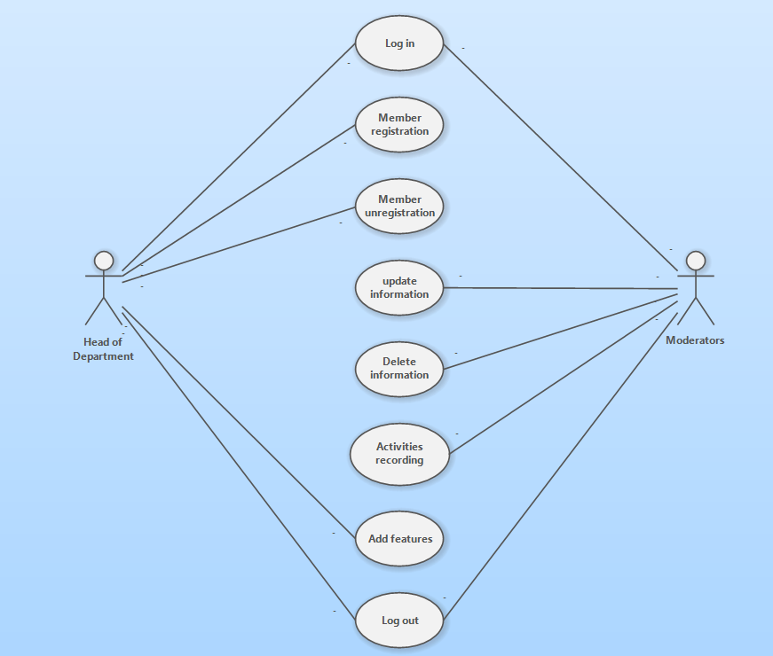
Use Case diagram for Head of department & Moderators

Slide 8
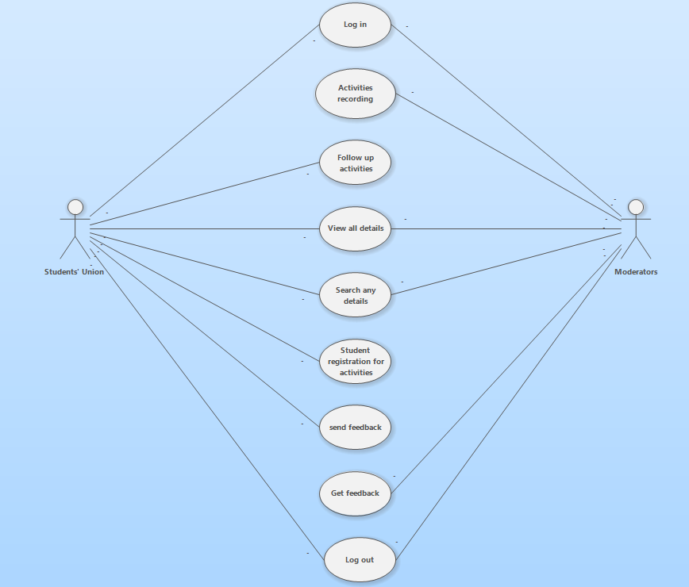
Use Case diagram for Moderators & Students' Union

Slide 9
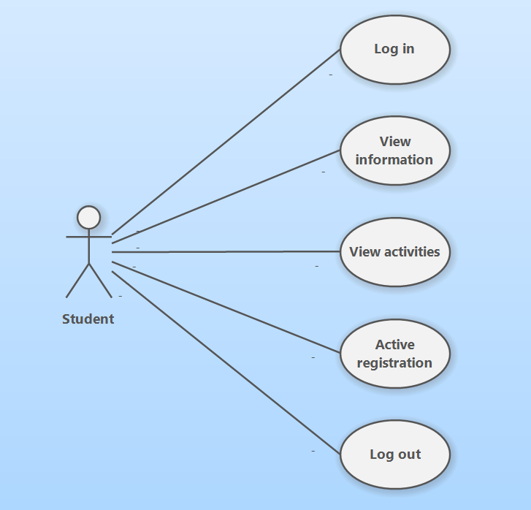
Use Case diagram for student

Slide 10
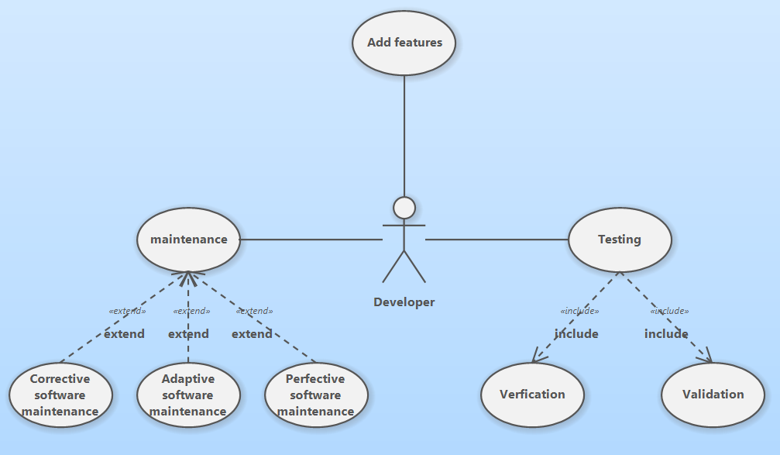
Use Case diagram for Developer

Slide 11
Class Diagram
Class diagram is a static diagram. It represents the static view of an application. Class diagram is not only used for visualizing, describing, and documenting different aspects of a system but also for constructing executable code of the software application. Class diagram describes the attributes and operations of a class and also the constraints imposed on the system. The class diagrams are widely used in the modeling of object-oriented systems because they are the only UML diagrams, which can be mapped directly with object-oriented languages. Class diagram shows a collection of classes, interfaces, associations, collaborations, and constraints. It is also known as a structural diagram.

Slide 12
Purpose of Class Diagram
The purpose of class diagram is to model the static view of an website. Class diagrams are the only diagrams which can be directly mapped with object-oriented languages and thus widely used at the time of construction. UML diagrams like activity diagram, sequence diagram can only give the sequence flow of the website, however class diagram is a bit different. It is the most popular UML diagram in the coder community

Slide 13
The purpose of the class diagram can be summarized as
Analysis and design of the static view of an application. Describe responsibilities of a system. Base for component and deployment diagrams. Forward and reverse engineering

Slide 14
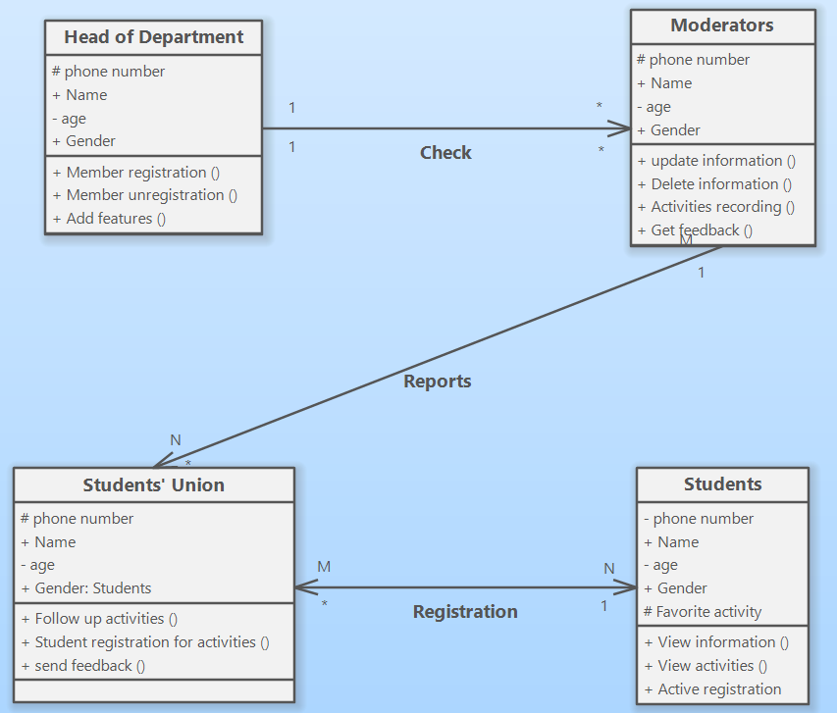
Class diagram

Slide 15
Demo

Slide 16

Sign in screen

Slide 17
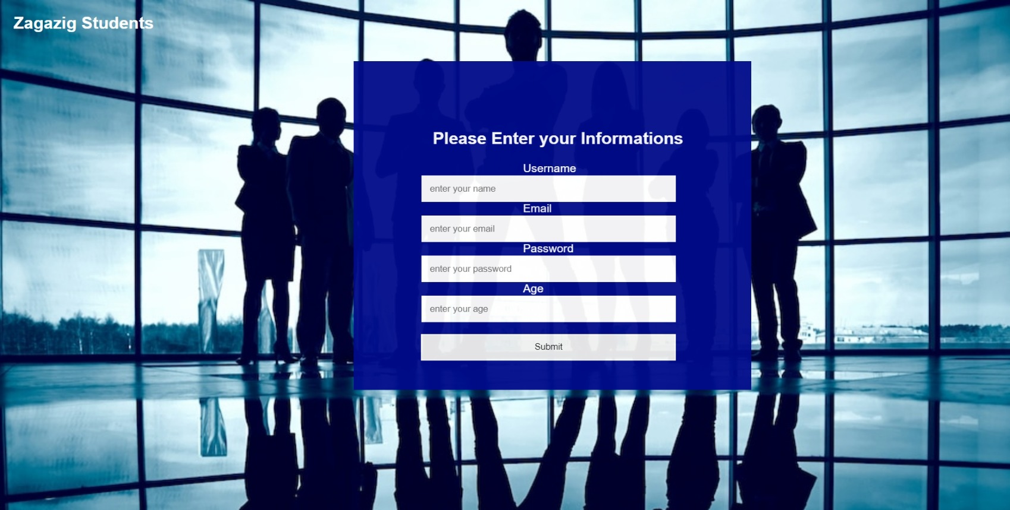
Sign up screen

Slide 18

Home Screen Page

Slide 19

services Page

Slide 20
Team roles

Slide 21
Name | Role
Abdullah Mahmoud Attya Ali | System Analysis
Abdelhamied Mohamed Elbakry | Front end development
Ahmed Essam Refat Elharty | Data Base and Documentation
Mostafa Ehab Ebrahim Khalil | Data Base and Documentation
Marwan Atef Ahmed Kamal | Back end development
Mohamed Eid Mohamed AboEldhab | Back end development

Slide 22

Do you have any question?

